Slide 1
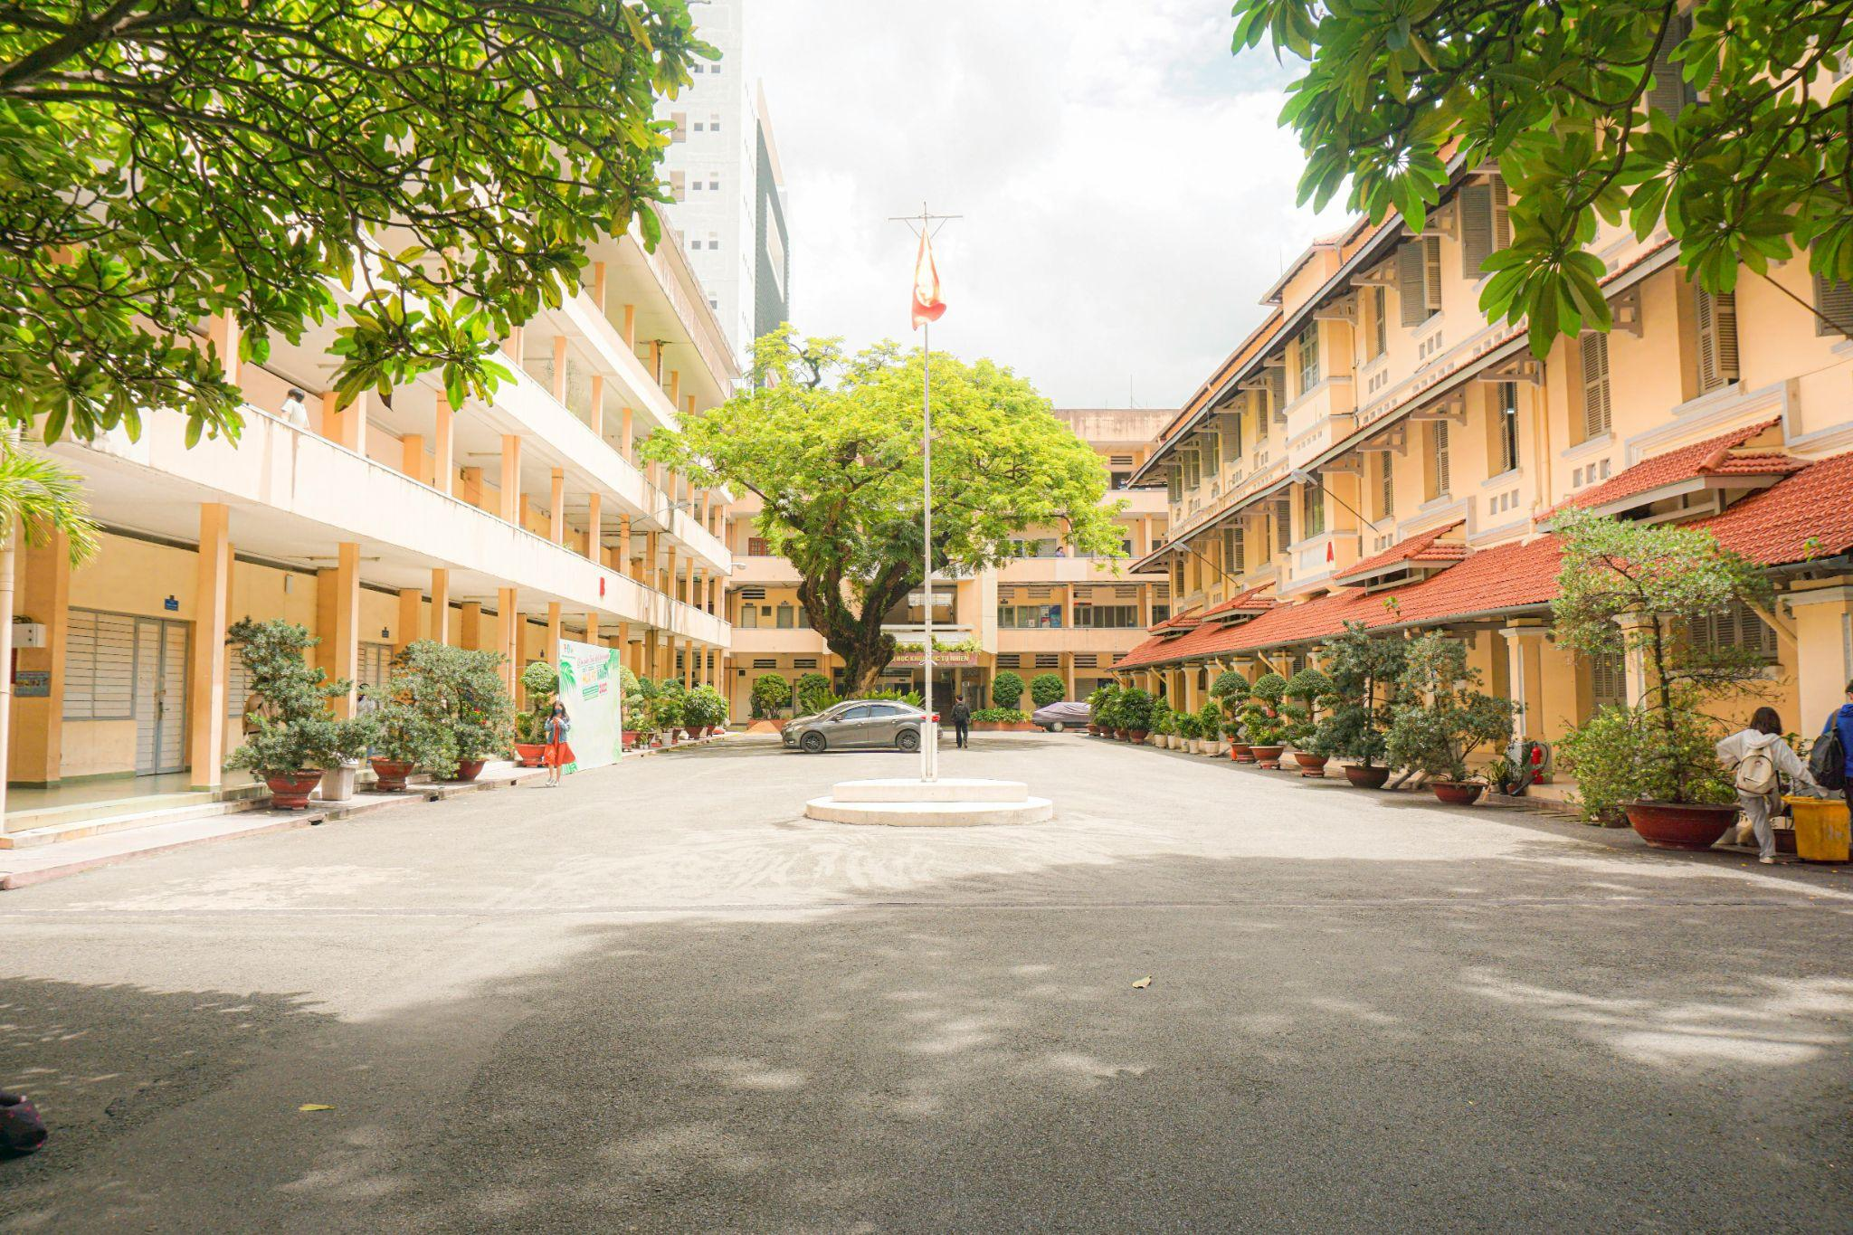
BACK TO SCHOOL

Slide 2
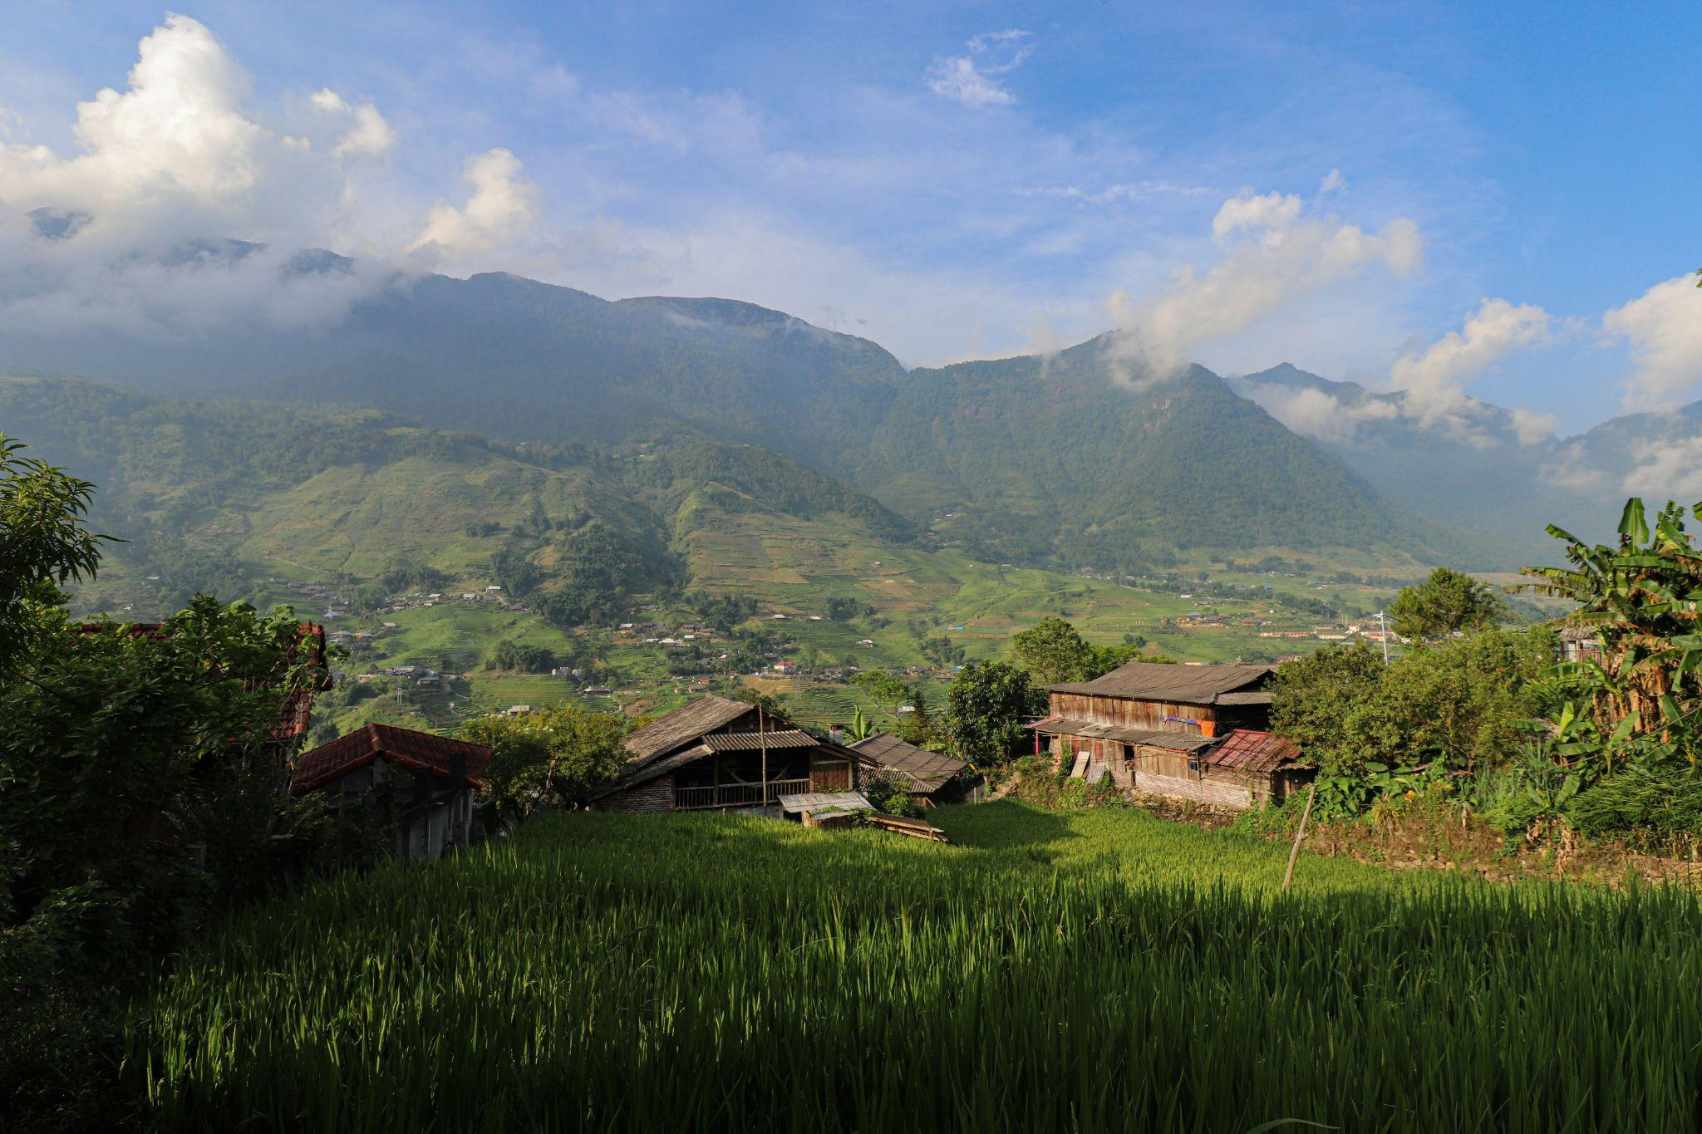
FARM LAND BUT LITTLE DIF STILL VIET

Slide 3
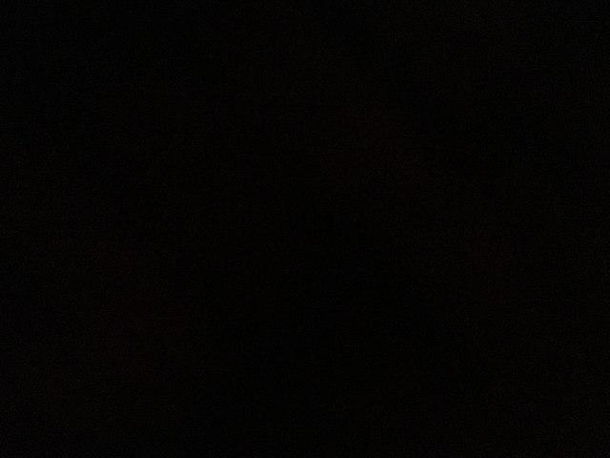
DARK. NOTHING. TIME SKIP
Notes:
Use for both bedroom and time skip scene. ANY SCENE in doors will not need a background

Slide 4
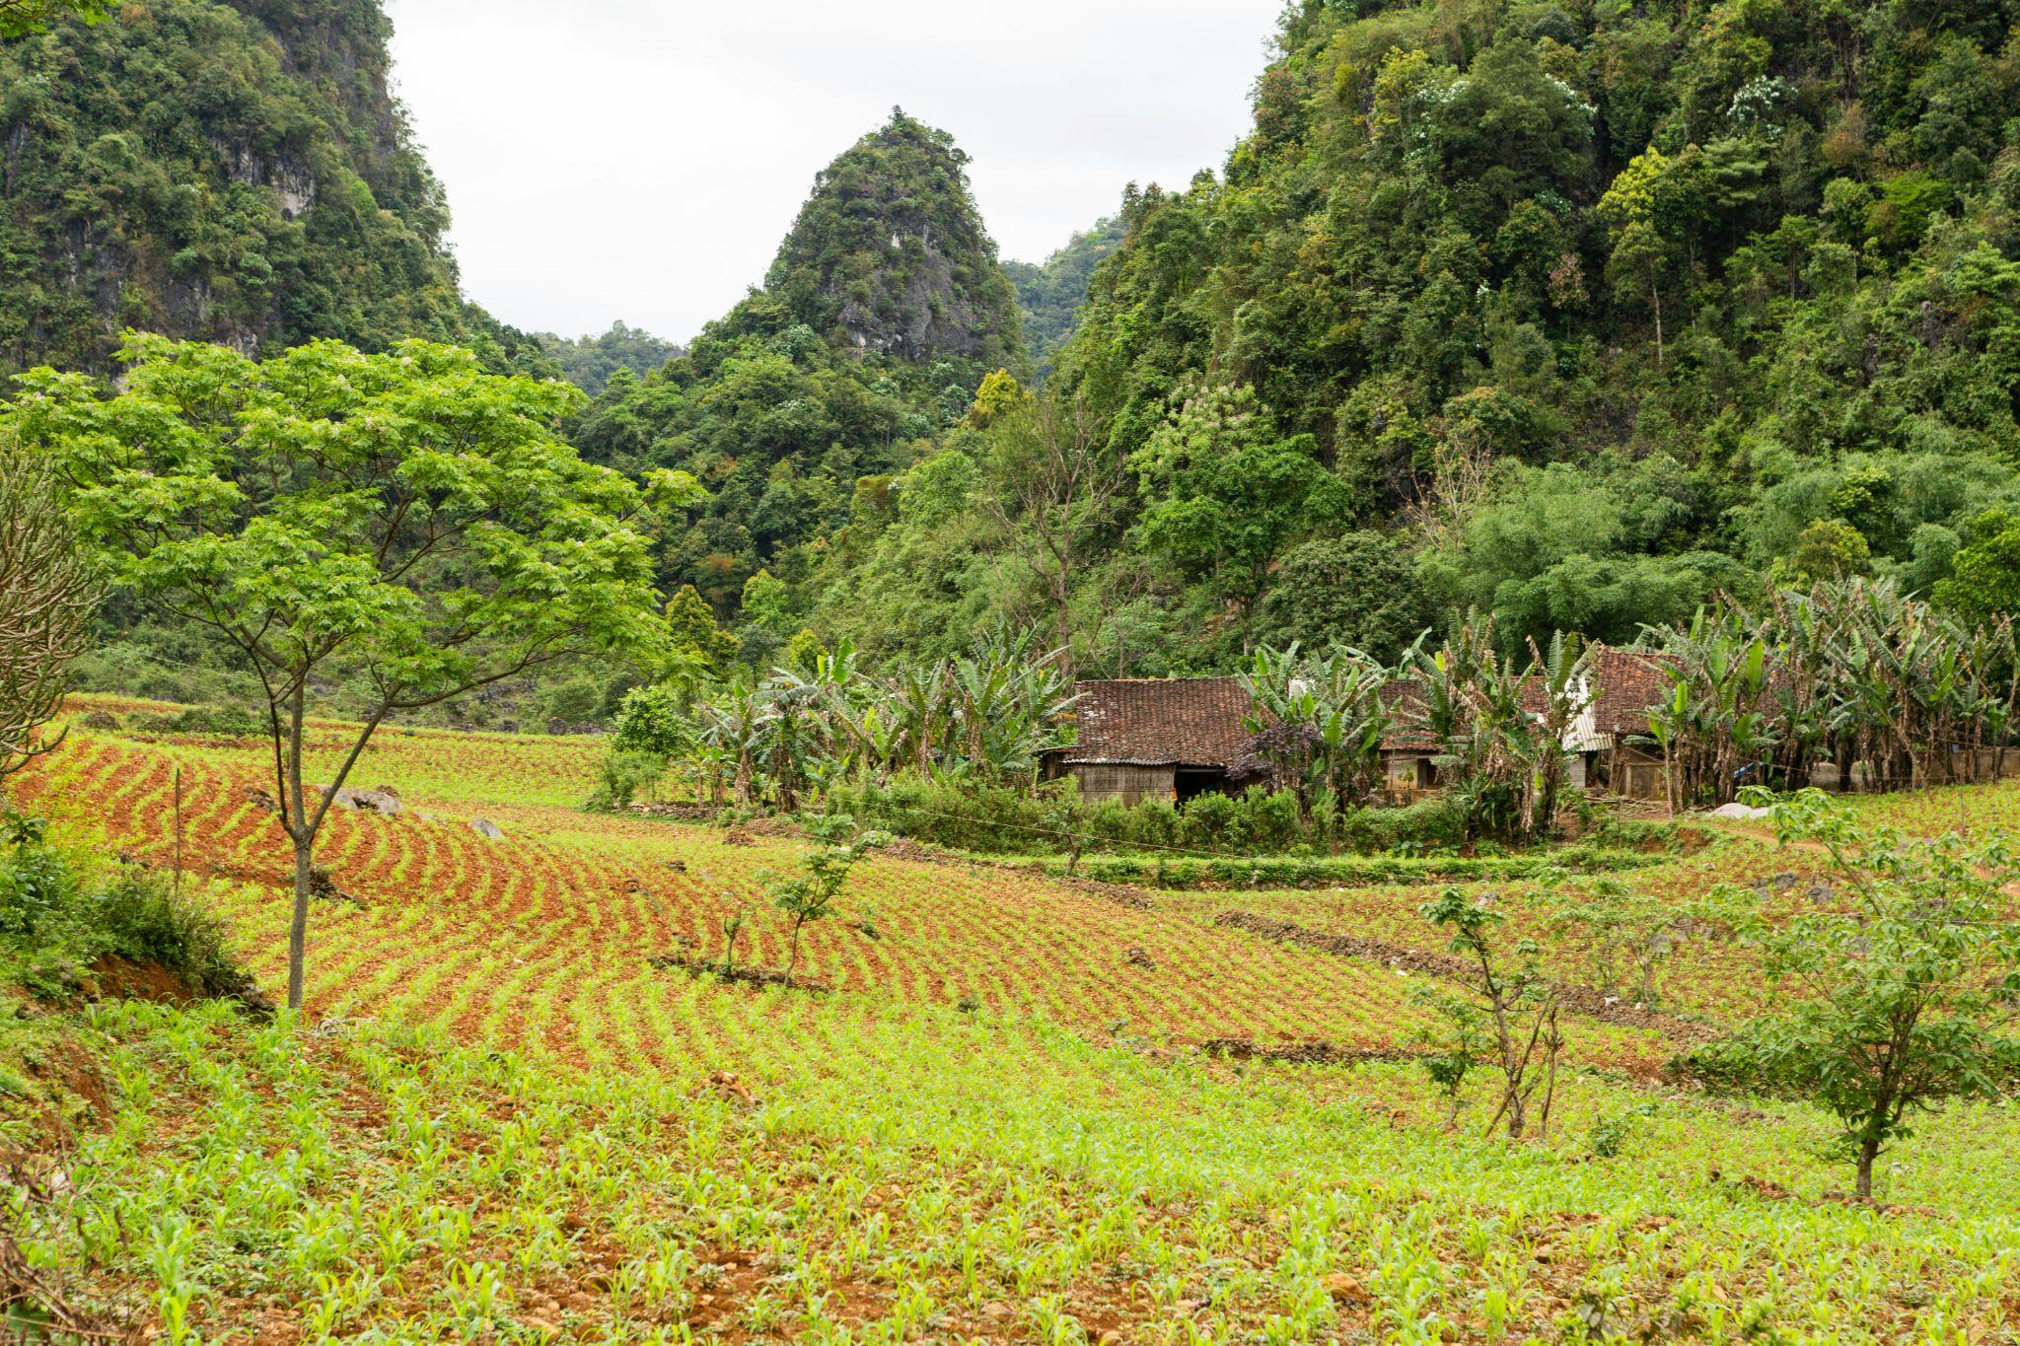
FARM LAND RICE SMALL HOUSER COUNTRY SIDE VIET
\
PICTURE HERE STEPHAN

Slide 5
DARK. NOTHING. TIME SKIP
Notes:
Scene 5 Is black filler for scenen change

Slide 6
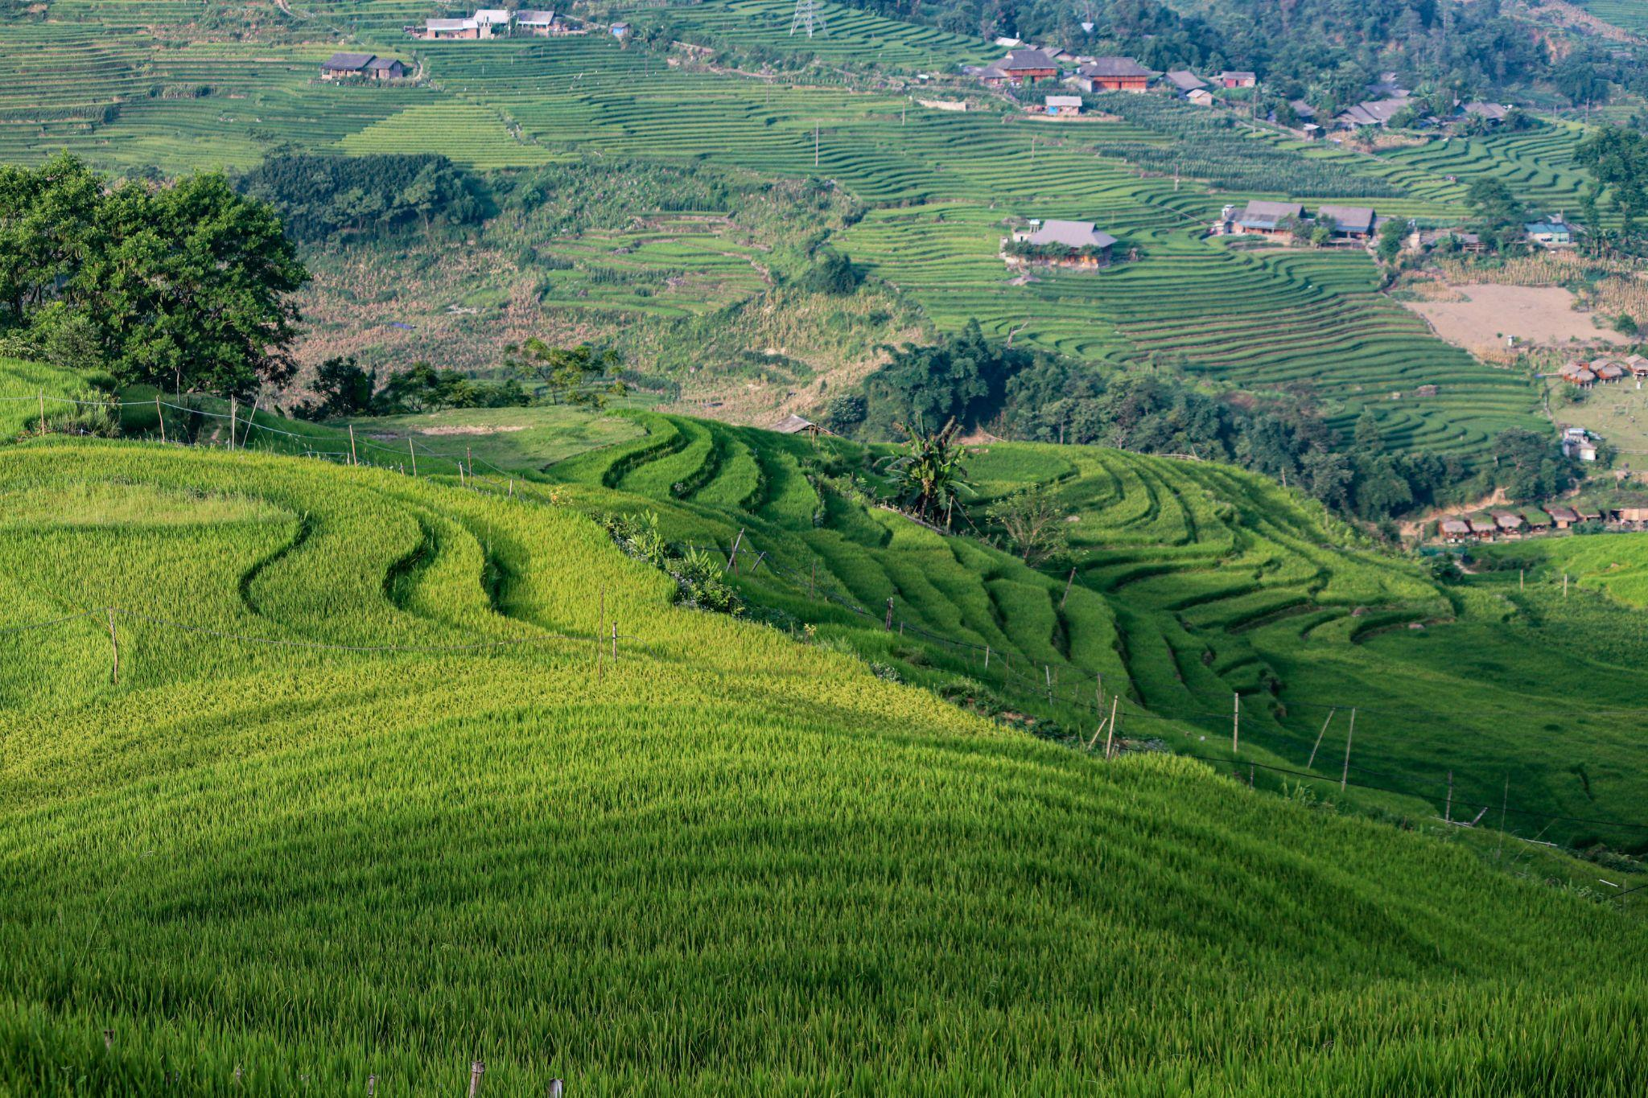
CEMETARY ON HILL VIET

Slide 7
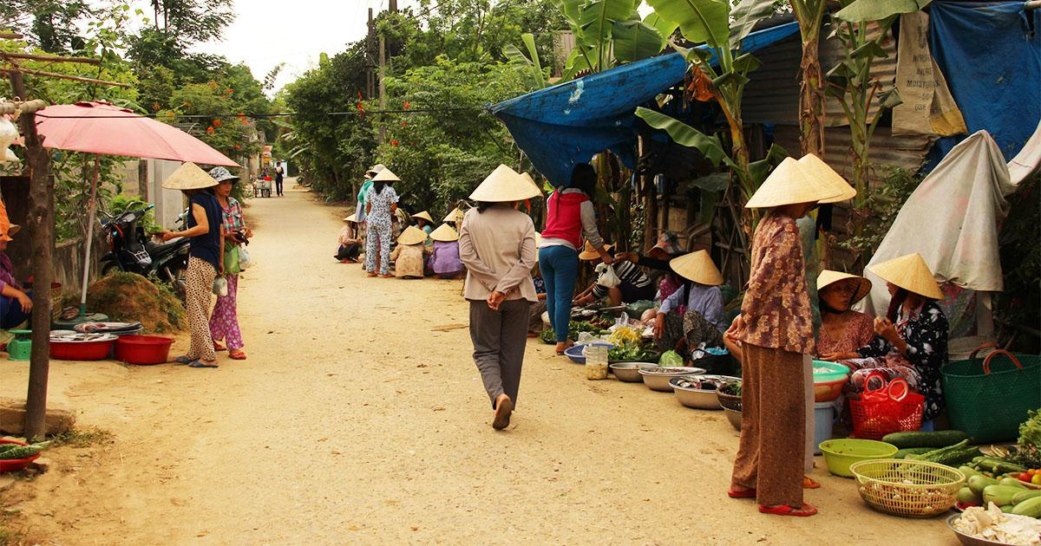
MARKET
Add here stephan

Slide 8
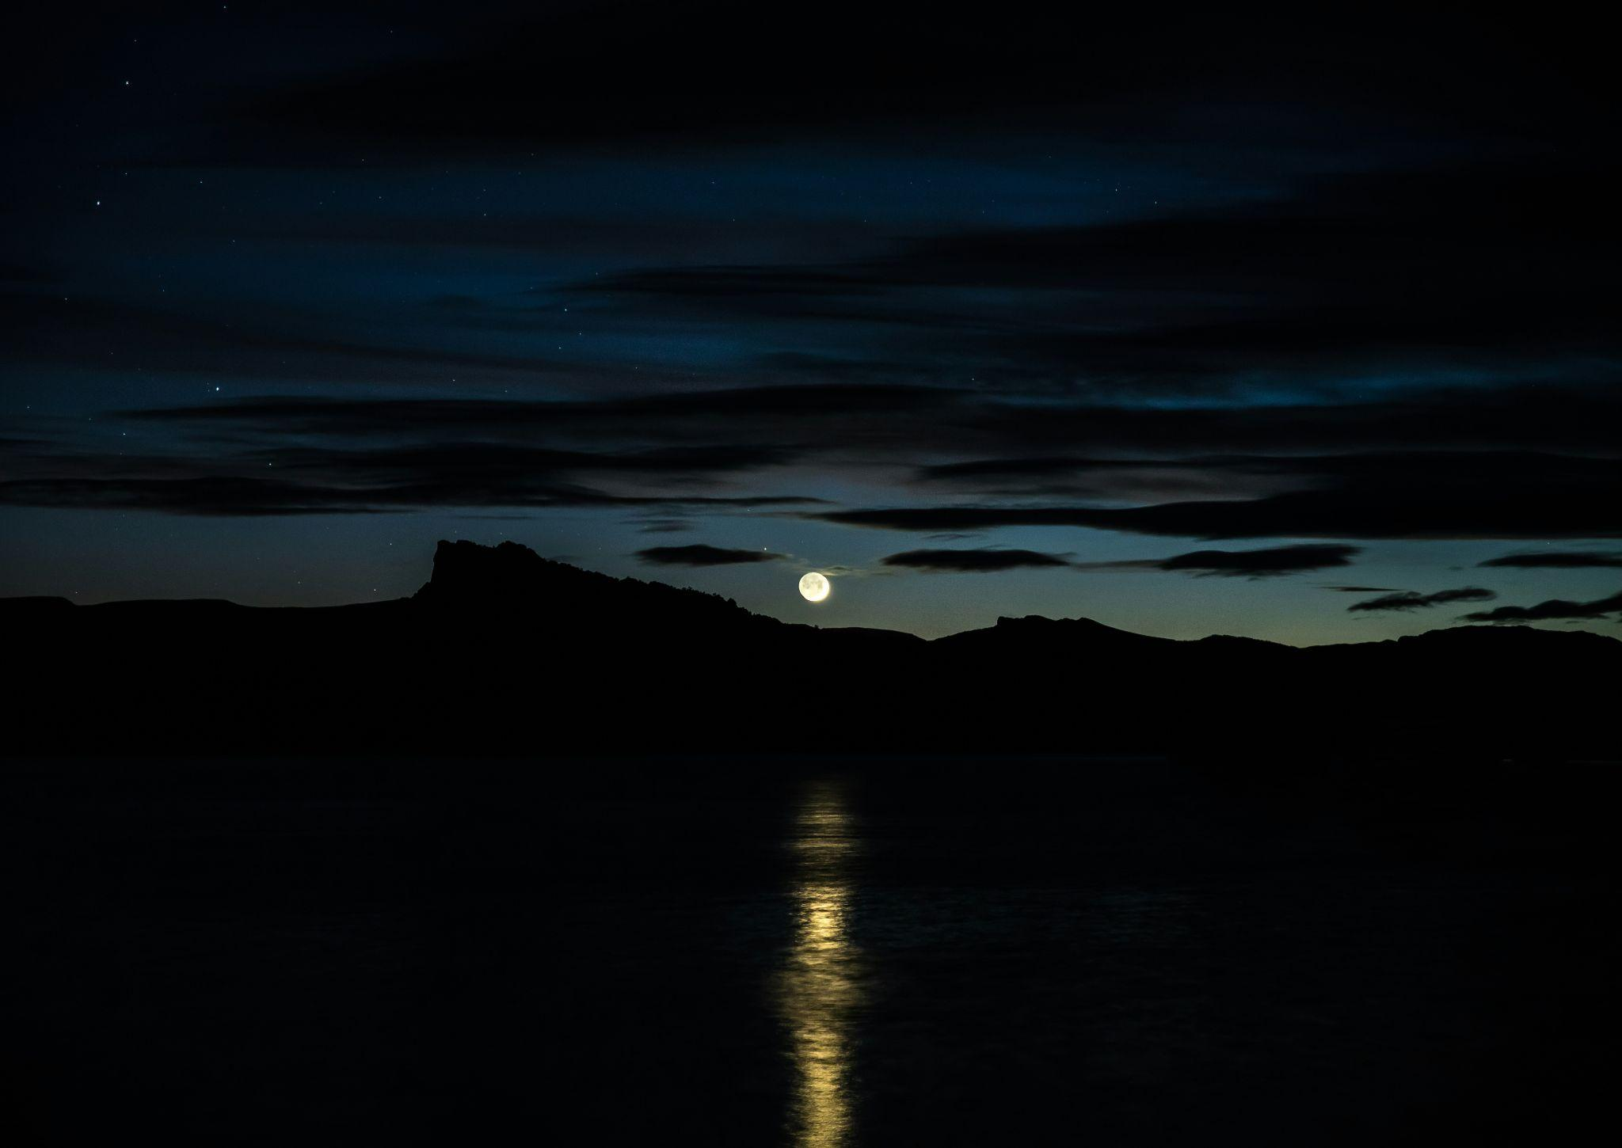
LAKE WITH WATER DARK GLOOMY NIGHT

Slide 9
DARK. NOTHING. TIME SKIP
Notes:
Use for both bedroom and time skip scene. ANY SCENE in doors will not need a background

Slide 10
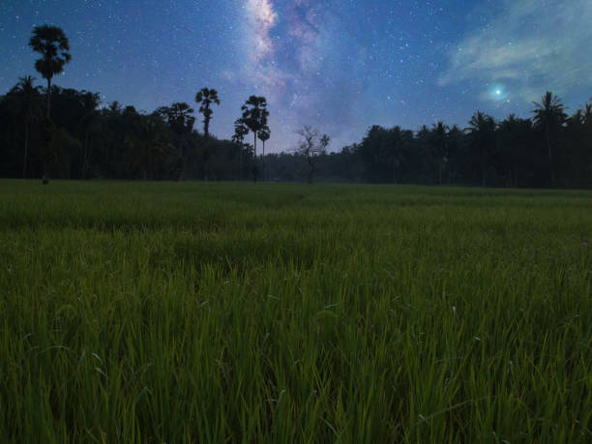

Black, then shadow (animation)

Slide 11
BACK TO SCHOOL

